Slide 1
THE BEST NEW BOOKS FROM ONLY £2.99
*Free books are subject to terms and conditions. Please contact your Book Fair Organiser or Scholastic Book Fairs for details.

Slide 2
SECONDARY SCHOOLS BOOK RANGE

Slide 3
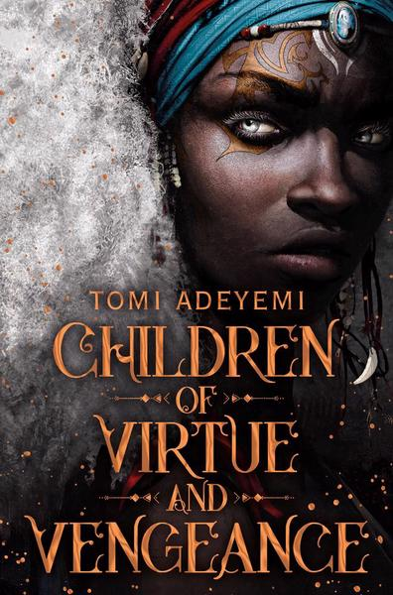
NEW AND EXCITING
13+
13+
13+
Something’s not right about the Riverdale Revels festival. Can Archie and his friends figure it out before it’s too late?
Zélie battles to unite the maji and avoid a civil war in this stunning sequel to Children of Blood and Bone.
Boy meets boy. Boys become friends. Boys fall in love. The next installment in the LGBTQ+ graphic novel series about life, love, and everything in between.

Slide 4
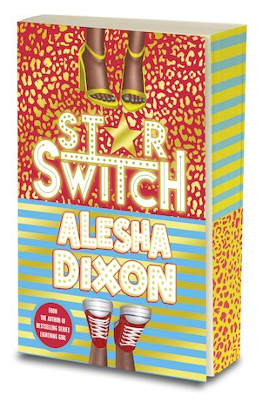
OUR FAVOURITES
From class misfit to fame and fortune, where will Cole's little white lie lead?
When you only have a few months left, how do you live a whole lifetime? Join Sam as he faces the biggest dilemma of his life: death.
A popstar tired of the limelight and her biggest fan longing to be her BFF – body swapped?!

Slide 5
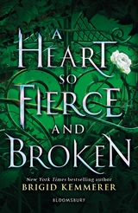
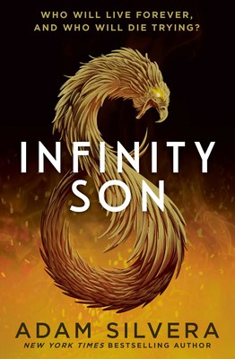
STEP INTO ANOTHER WORLD
13+
13+
13+
Find the heir, win the crown. Win the crown, save the kingdom. But ‘Happily Ever After’ isn’t always that simple…
The author of The Raven Cycle soars again. The dreamer. The thief. The hunter who wants Ronan to sleep tight forever...
Two brothers caught up in a magical war. Brotherhood, love, and loyalty will be put to the test, and no one will escape the fight unscathed.

Slide 6
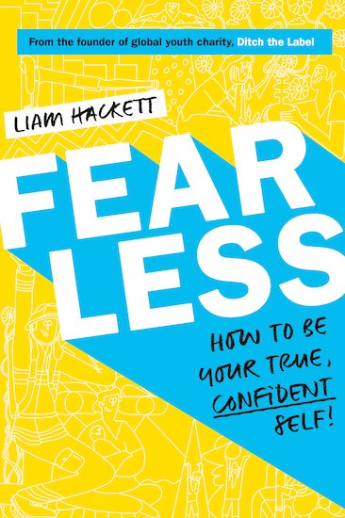
EMPOWERING READS
With advice to help children find the confidence to be their true selves, FEARLESS is a guide to being your best self from Liam Hackett, founder of anti-bullying charity Ditch the Label.
The essential guide to encourage powerful, positive thinking and body confidence, offering cool, calm, practical and friendly advice.

Slide 7
ON YOUR SCREEN
Lara Jean has written a love letter for every boy she's ever loved. They're for her eyes only - until they're mailed out! The sequel to To All The Boys I’ve Loved Before, coming soon to Netflix!
Elle Evans seems to have finally tamed bad boy Noah Flynn, but now they're facing a new challenge. Noah's 3,000 miles away at Harvard, and long-distance is tough.
This Riverdale journal is the best place to note down your very own thoughts and secrets. With guided elements, fill-in activities, quizzes, lined pages and more!

Slide 8
HAVE A GREAT BOOK FAIR!
For more books visit www.bookfairs.scholastic.co.uk/books

